Slide 1
Introduction to R
Rob Kabacoff, Ph.D.

Slide 2
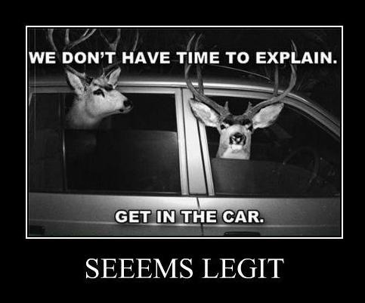

Slide 3
Part I. Introduction

Slide 4
Part 1 Topics
Overview
IDEs and GUIs
Syntax
Workspace
Help
Interactive and Batch
Packages
Getting Unstuck

Slide 5
What is R
A language and environment for statistical computing and graphics
Based on the "S" Language developed at Bell Labs
R was first created by Ross Ihaka and Robert Gentleman at the Univ. of Auckland in 1993

Slide 6
Why use R?
Free
Open source
State-of-the-art graphics and data analysis
Platform for programming new methods
Runs on Windows, Linux, Mac OS X
Enormous user base

Slide 7
Statistical Methods
Descriptive Statistics
Experimental Design
Linear , Generalized, Nonlinear, and Hierarchical Models
Analysis of Categorical Data
Nonparametric Analysis
Survival Analysis
Latent Variable Models
Bayesian Models
Missing Values Analysis
Cluster Analysis
Decision Trees
Data Mining
Classical Test Theory
Item Response Theory
Correspondence Analysis
Multidimensional Scaling
Meta Analysis
Structural Equation Modeling
Complex Survey Design
Time Series Analysis
Longitudinal Analysis
Social Network Analysis
Study of Mediation and Moderation
Power Analysis
Clinical Trials
and …

Slide 8
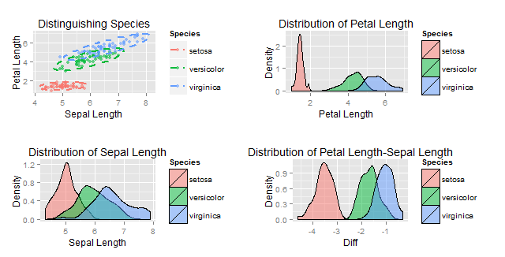
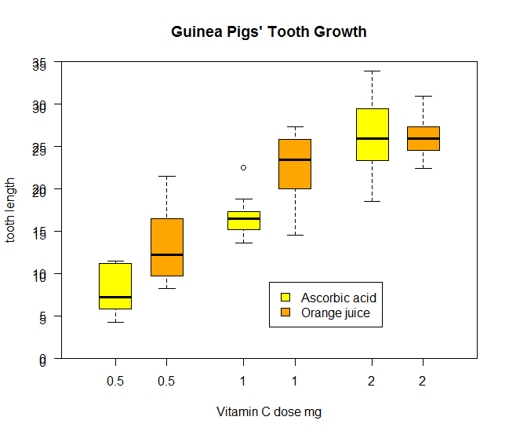
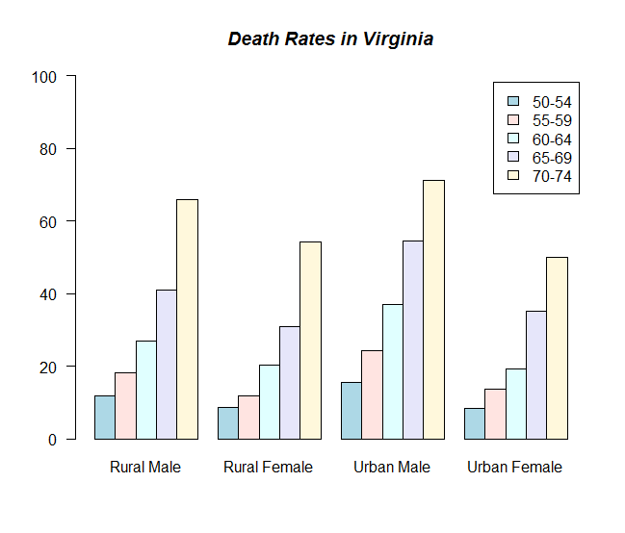
Graphs!

Slide 9
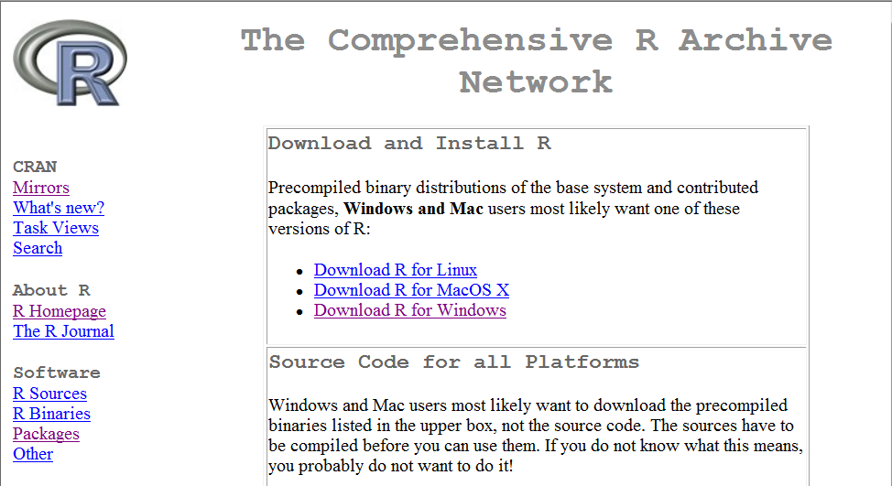
Obtaining R
R Homepage - http://www.r-project.org/
CRAN Mirrors – http://cran.r-project.org/

Slide 10
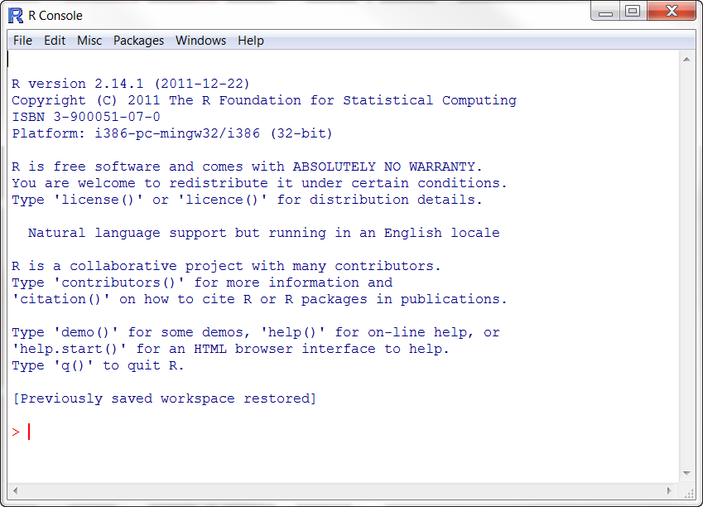
Default Console

Slide 11
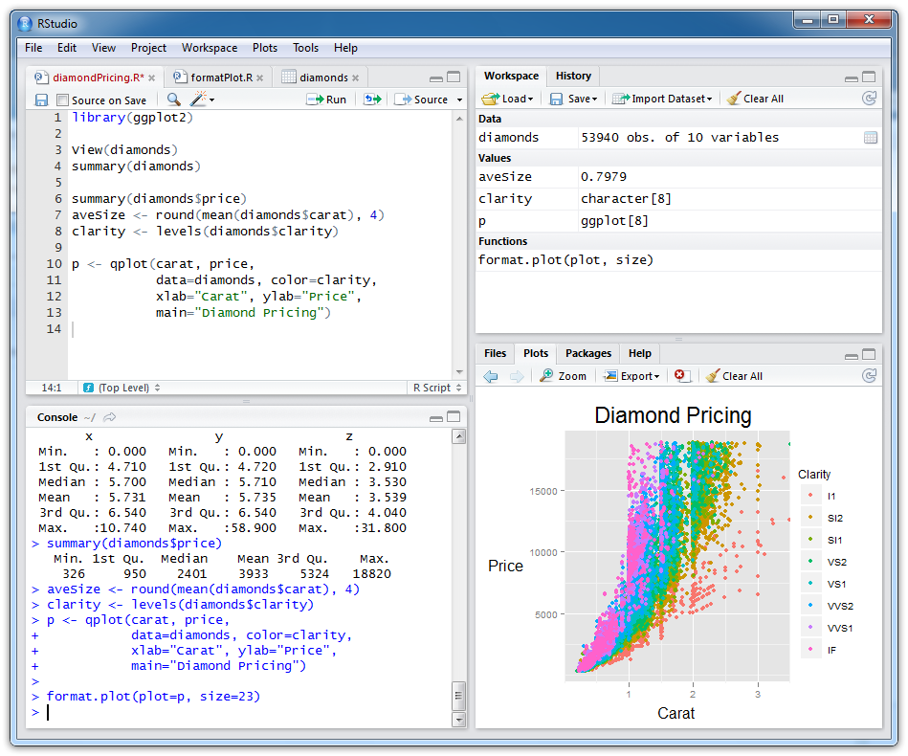
Rstudio (http://rstudio.org/)

Slide 12
Working with R
Case-sensitive interpreted language
Enter commands at prompt (>) or in batch
Statements consist of functions and assignments
Comments are preceded by #
semi-colon separates statements on a line
x <- c(4, 4, 5, 6, 7, 2, 9)
length(x) ; mean(x)
plot(x) # plot the vector

Slide 13
Some definitions
An object is anything that can be assigned to a variable.
Includes constants, data structures, functions, and even graphs
Objects have a mode - how the object is stored.
Objects have a class - which tells generic functions like print() how to handle it.

Slide 14
R Workspace
Your current R working environment
Includes any user-defined objects (vectors, matrices, functions, data frames, lists)
At end of session you can save image of the workspace and it will be automatically loaded next time R starts

Slide 15
Functions for managing workspace
Function | Action
getwd() | List current working directory
setwd("mydirectory") | Change the current working directory to mydirectory
rm(object) | Delete object
save(objectlist, file="myfile") | Save specific objects to a file
load("myfile") | Load a workspace into the current session (default = .RData)

Slide 16
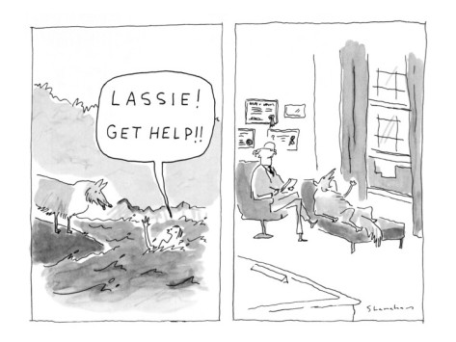

Slide 17
Getting Help
Function | Action
help("foo") ?foo | Help on function foo (the quotation marks are optional)
help.search("foo") ??foo | Search the help system for instances of the string foo
help(package="foo") | Help on package foo
example("foo") | Examples of function foo (the quotation marks are optional)
data() | List all available datasets for currently loaded packages

Slide 18
Packages
Collections of R functions, data, and compiled code in well-defined format
Massively extend the functionality of R
Thousands of user written packages on CRAN http://cran.r-project.or/web/packages

Slide 19
Working with Packages
install.packages("packagename")
update.packages()
library(packagename)
help(package="packagename")

Slide 20
Sample session
install.packages("vcd")
help(package="vcd")
library(vcd)
help(Arthritis)
Arthritis
example(Arthritis)

Slide 21
Common Mistakes
Using the wrong case. help(), Help(), and HELP() are three different functions (only the first will work).
Forgetting to use quote marks when they are needed. install.packages("gclus") will work, while install.packages(gclus) will generate an error.
Forgetting to include the parentheses in a function call. help() rather than help. Even if there are no options, you still need the ().

Slide 22
Common Mistakes (2)
Using the \ in a path name on Windows. R sees the backslash character as an escape character. setwd("c:\mydata") will generate an error. Use setwd("c:/mydata") or setwd("c:\\mydata") instead.
Using a function from a package that is not loaded. The function order.clusters() is contained in the gclus package. If you try to use it before loading the package, you will get an error.

Slide 23
Resources

Slide 24

Look it up on Google
“summary statistics in r”
“specifying colors in a barchart in r”
“rotating labels in ggplot2”
Error messages

Slide 25
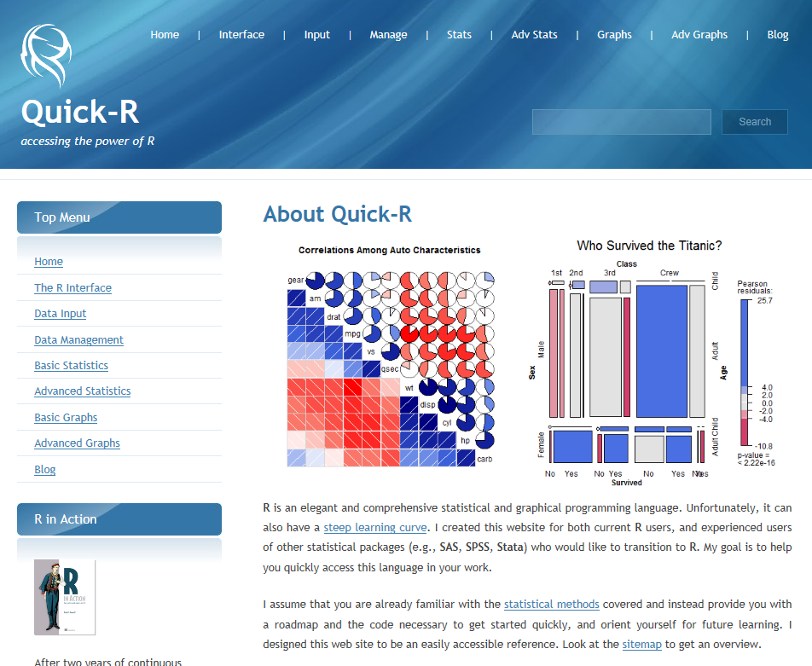
www.statmethods.net

Slide 26
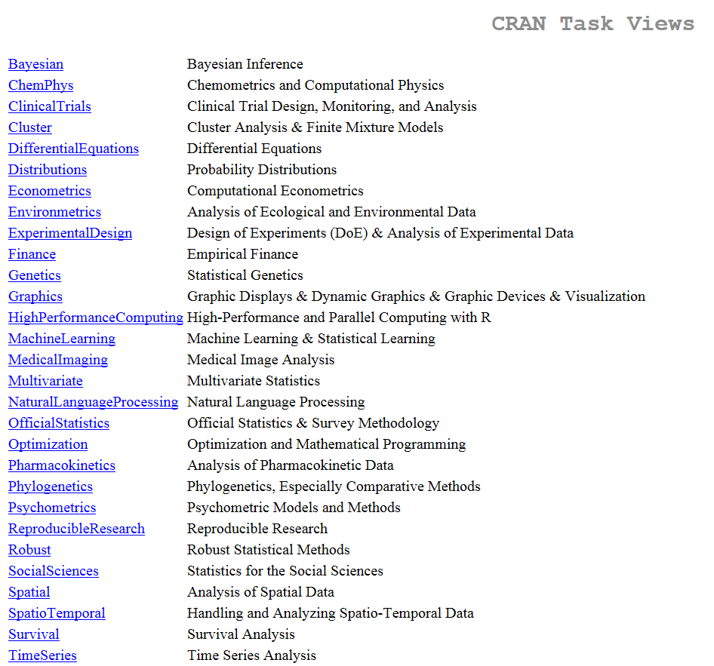
Find the functions you need
CRAN Task Views

Slide 27
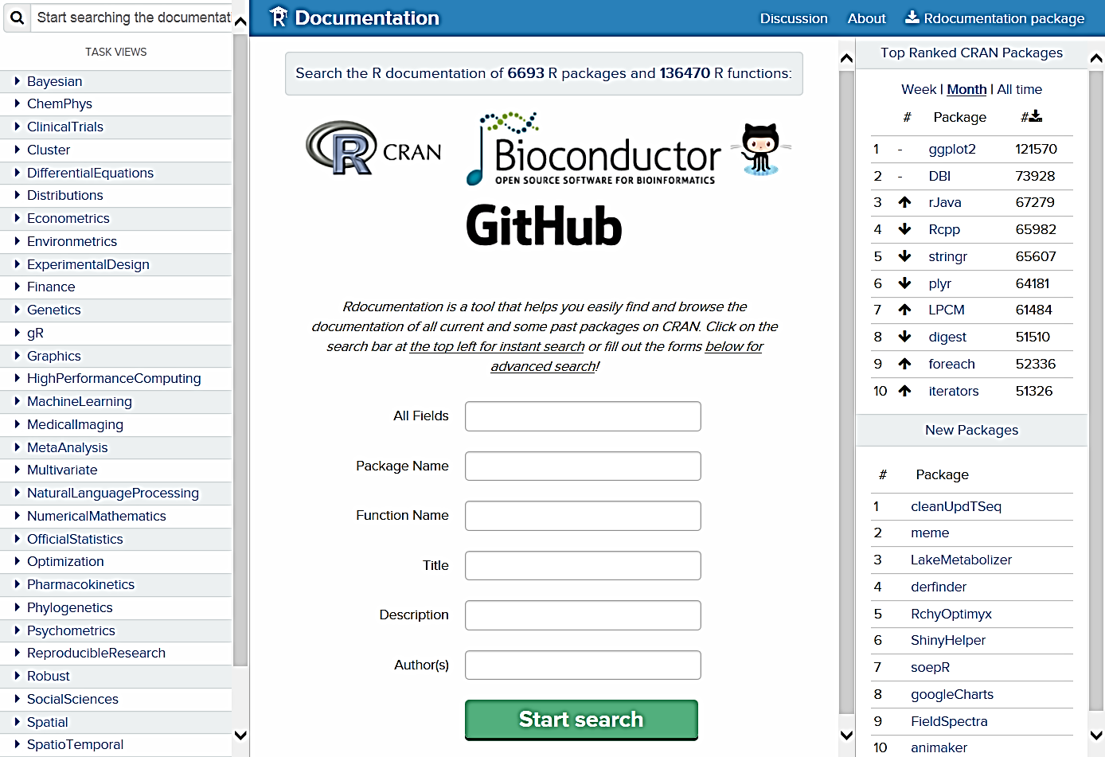
Finding Functions : http://www.rdocumentation.org

Slide 28
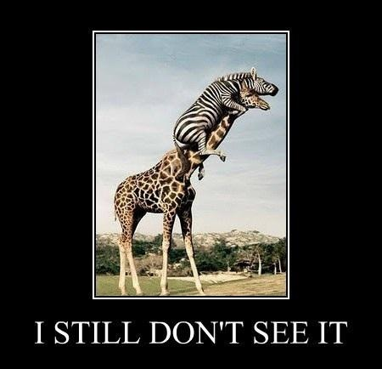

Slide 29
When you're really stuck
Stack Overflow http://stackoverflow.com/questions/tagged/r

